Slide 1

Final Project
Dixon + Ratz
August 10, 2021
Intro to Data Science Summer Course
Notes:
-Introduction-

Slide 2

Prerequisites
Library:
Tidyverse
Dplyr
Ggplot2
Scales
lubridate

Slide 3

Introduction
Netflix provide its users a plethora of shows to watch. The data set we’re using comes from Shivam Bansal. This data set is broken down into multiple columns, some of which are removed to irrelevance to the data set. The columns are the following:
Type
Title
Director
Country
Release Year
Rating
Duration
Listed_In

Slide 4

Data Exploration & Analysis
Let’s dive in

Slide 5
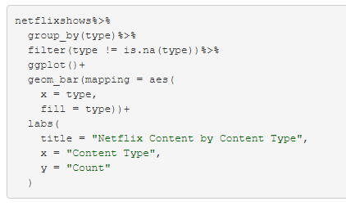
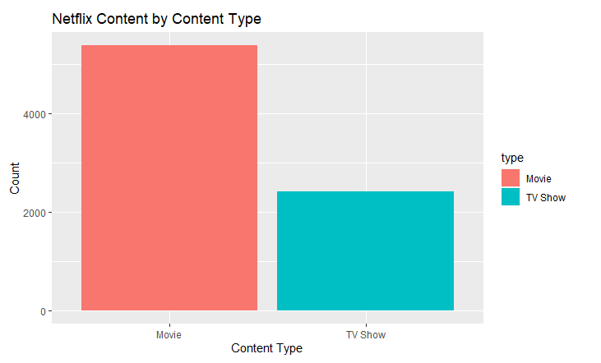
Content Types
The visualization below graphically represents the distribution of the content released on Netflix’s platform. They can be either labeled as ‘Movie’ or a ‘TV Show’.

Slide 6
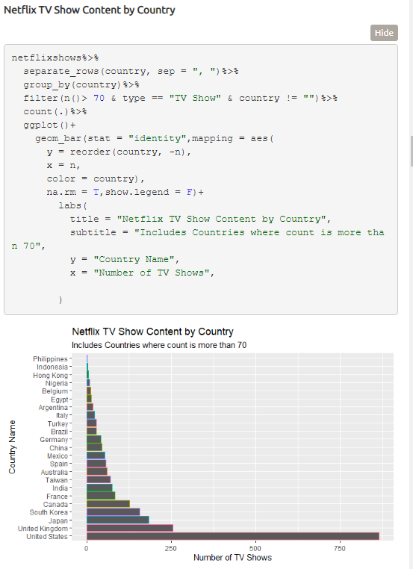
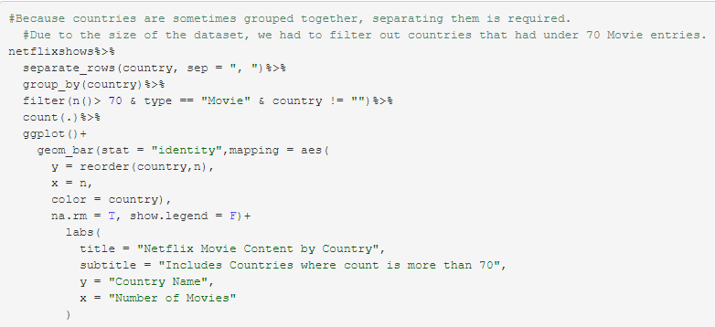
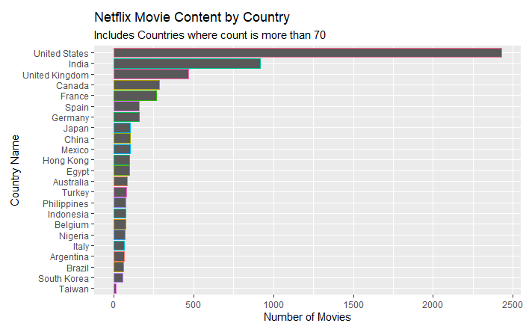
Content Type by Country
Notes:
This next visualization graphically demonstrates the distribution of content on Netflix per country. Content is separated by the Type of Content it is, either Movie or TV Show.

Slide 7

Analyzing potential Data Relationships
How does Data A have a relationship to Data B?

Slide 8
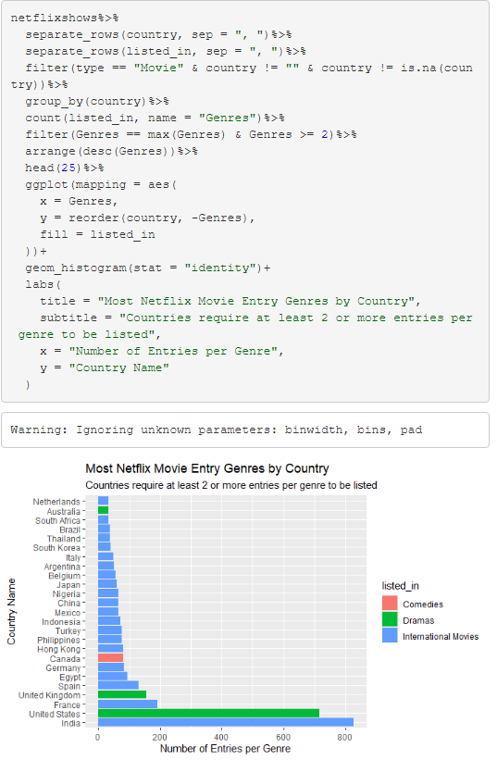
Genres
Each Country has their own favorite type of Genre. Below is a graphical representation of the relationship between Genres and associating countries. The data is separated by content type, either “Movie” or “TV Show”. A graph like this is helpful to answer questions such as:
What Genre does each country prefer?
Which country has the most of that specific genre?
What is the target audience per country?
Is Netflix showing appropriate content genres per country?

Slide 9
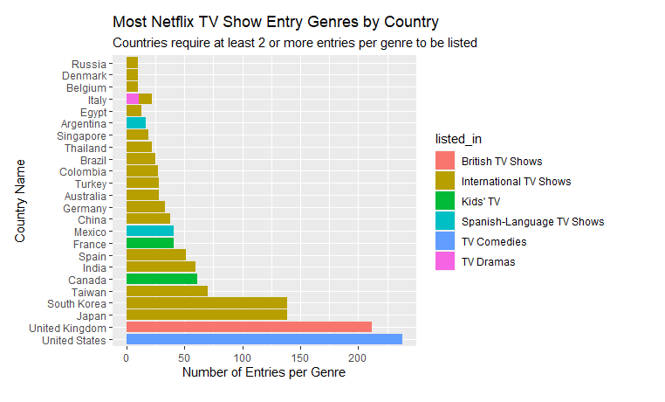
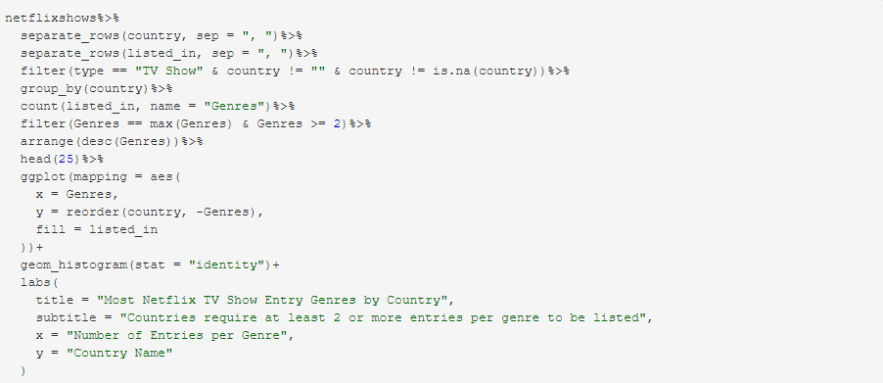
Genres pt.2

Slide 10
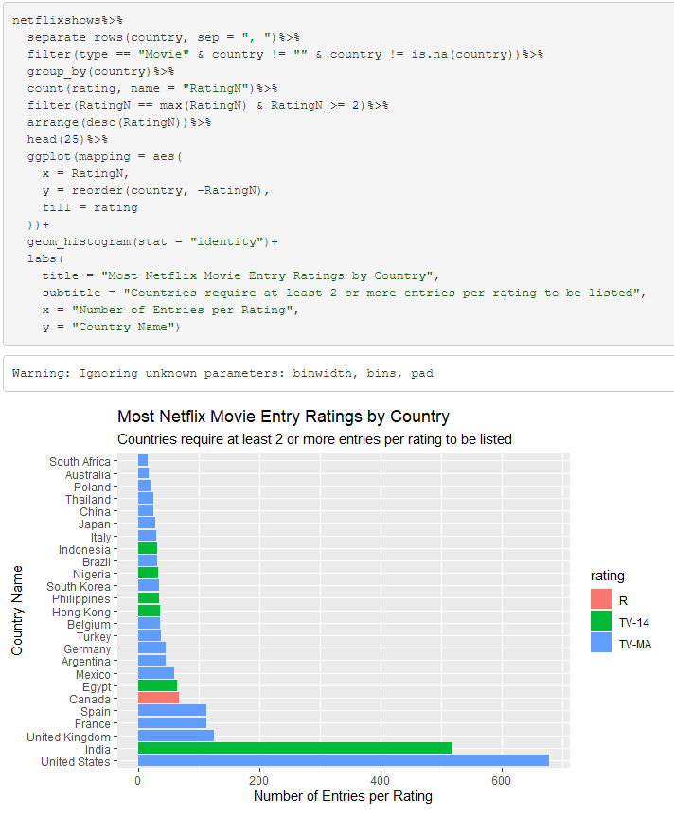
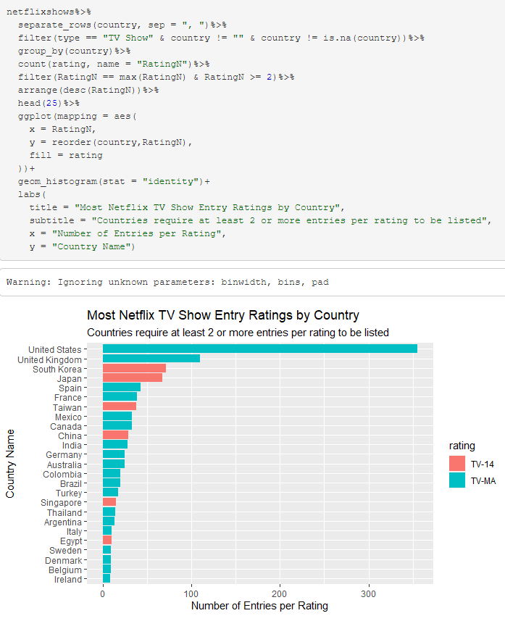
Ratings
Notes:
Some countries have regulations on what certain platforms, such as Netflix, can show Below is a graphical representation of the average rating for each country. The reason a graph such as this is helpful because it helps answering questions such as:
What rating is most appropriate per country?
What age group is most prevalent per country?
Does Netflix prefer to target older or younger audiences?

Slide 11
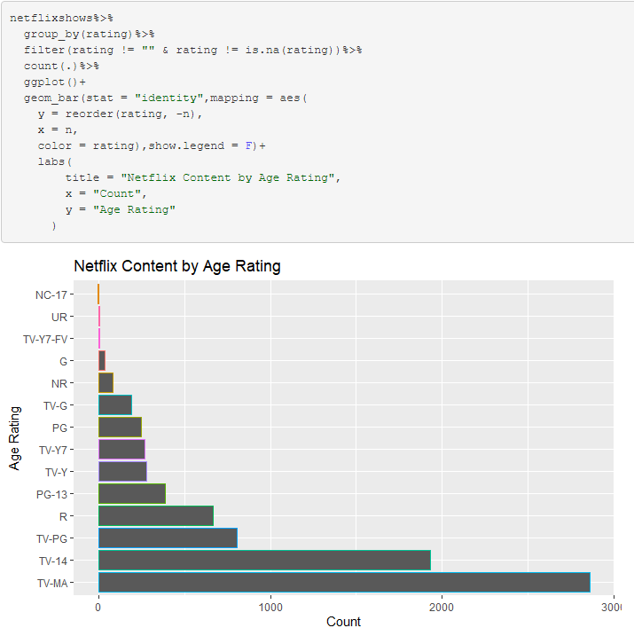

Average Rating per Country
Potential connection?
Notes:
Netflix rates all of their shows in a way that suggests appropriate ages see appropriate material. The graph below demonstrates the distribution between Netflix’s content and the associating Age rating.

Slide 12
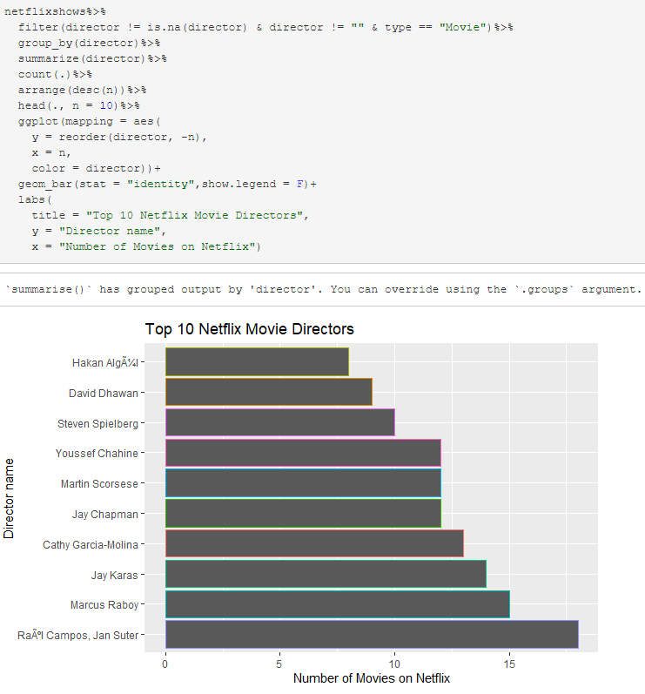
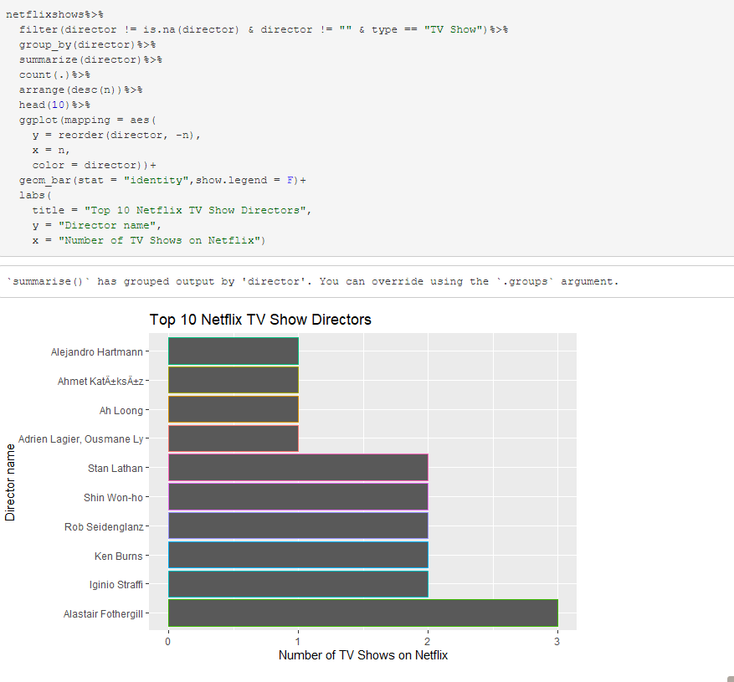
Top Directors
Notes:
Netflix likes to hire directors over and over if they keep pumping out content that is popular. On the screen is a graphical representation of the top 10 directors featured on Netflix and the number of entries they released, both for Movies and TV Shows.

Slide 13

Conclusion
After further analysis of the data set, we’ve gathered enough data to answer the questions that we asked.
The use of the Netflix Dataset, even though it wasn’t supplied to us via github, made an excellent source of information. The abundance of data and variables made it a good visual representation of Netflix as a whole. Through the course of this project, we learned the importance of clear and concise visual representations to help convey an overall message. The use of our skills helped strengthen our knowledge of R as a language and R Studio as an effective IDE to use. We were able to apply data manipulating tools, such as ‘mutate()’, ‘filter()’, and others.

Slide 14
Citations
Special thanks to Shivam Bansal for providing the Netflix Dataset, which can be found here!
For more detailed report, please click here!

